Slide 1
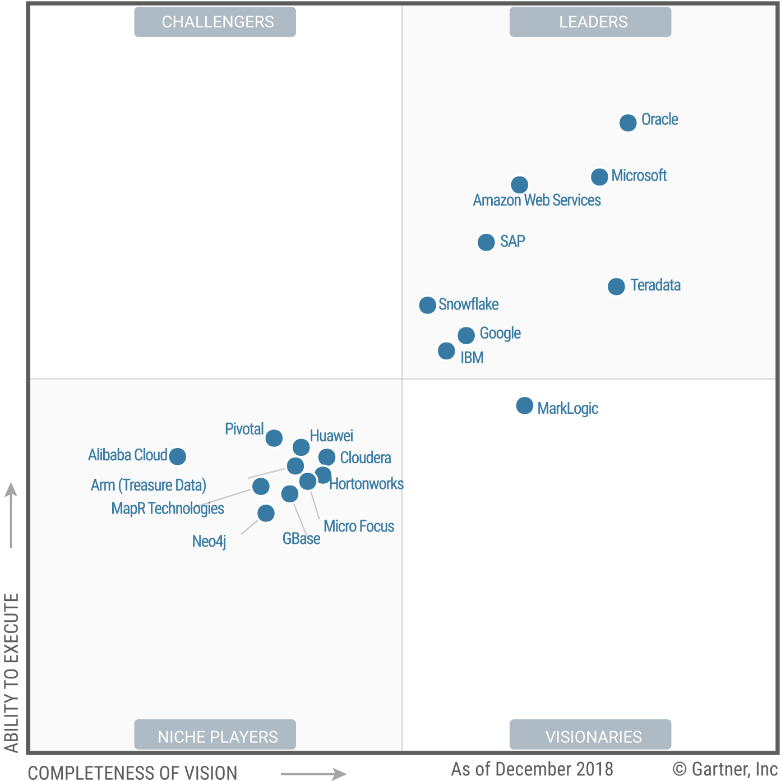
Understanding how Snowflake uses AWS S3.
Gartner’s “Magic Quadrant for Data Management Solutions for Analytics.”

Slide 2
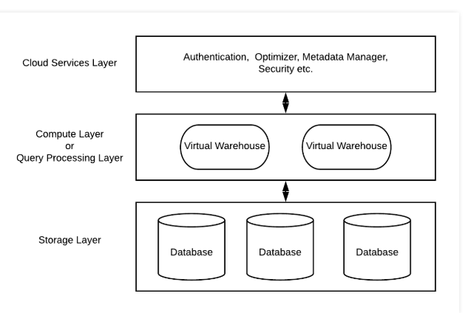
AWS S3 – how Snowflake uses it
Snowflake Architecture
AWS S3 is used for storage layer of Snowflake. The database storage layer resides in a scalable cloud storage service, such as Amazon S3, which ensures data replication, scaling and availability without any management by customers.

Slide 3
AWS S3 – how Snowflake uses it
Snowflake Architecture

Slide 4
AWS S3 – how Snowflake uses it
Snowflake uses S3 not only for table data.
It also uses S3 to store temp data generated by query operators (e.g. massive joins) once local disk space is exhausted, as well as for large query results.
Spilling temp data to S3 allows the system to compute arbitrarily large queries without out-of-memory or out-of-disk errors.
Storing query results in S3 enables new forms of client interactions and simplifies query processing, since it removes the need for server-side cursors found in traditional database systems.
Metadata such as catalogue objects, which table consists of which S3 files, statistics, locks, transaction logs, etc. is stored in a scalable, transactional key-value store, which is part of the Cloud Services layer.

Slide 5
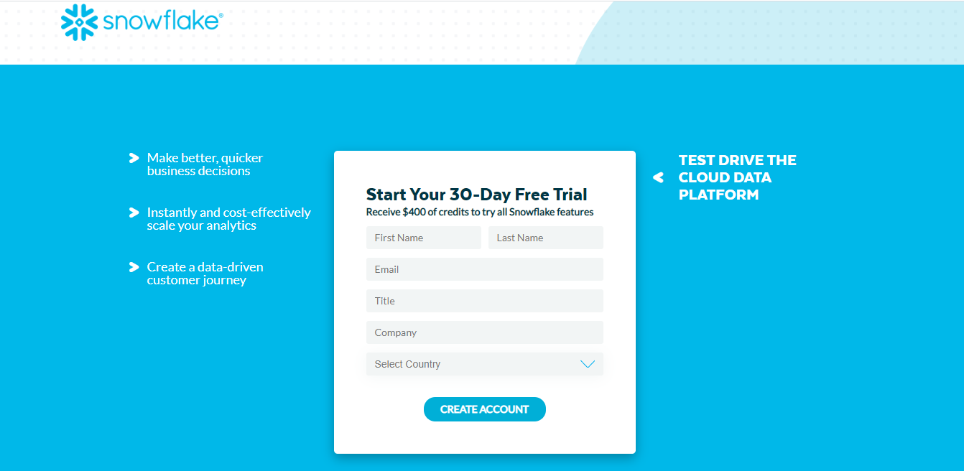
Configuration AWS S3 with Snowflake
Configuration is done while registering.

Slide 6
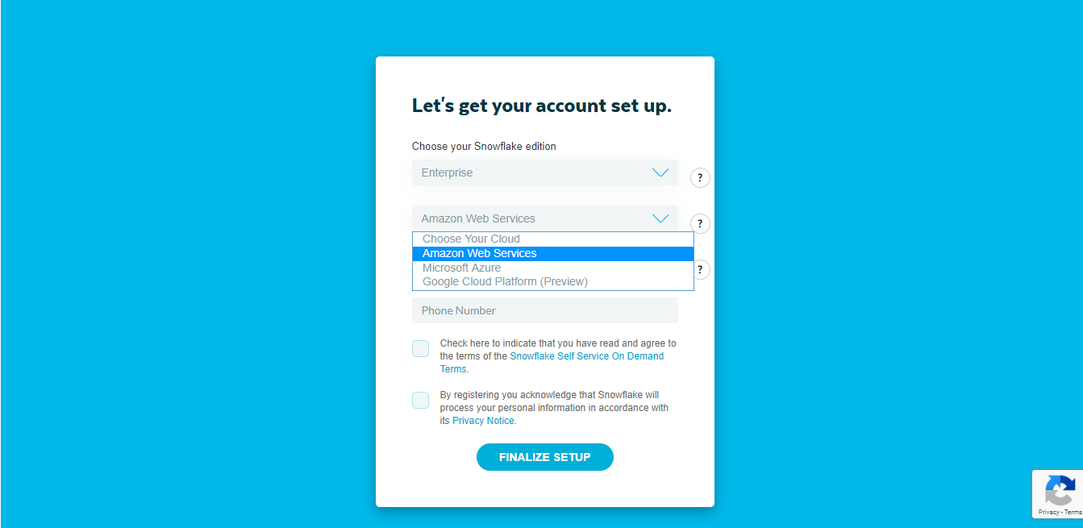
Configuration AWS S3 with Snowflake
We do this configuration step while registering, simply choose the cloud provider.
Snowflake is integrating S3 internally, so we are not performing any integration operation.

Slide 7
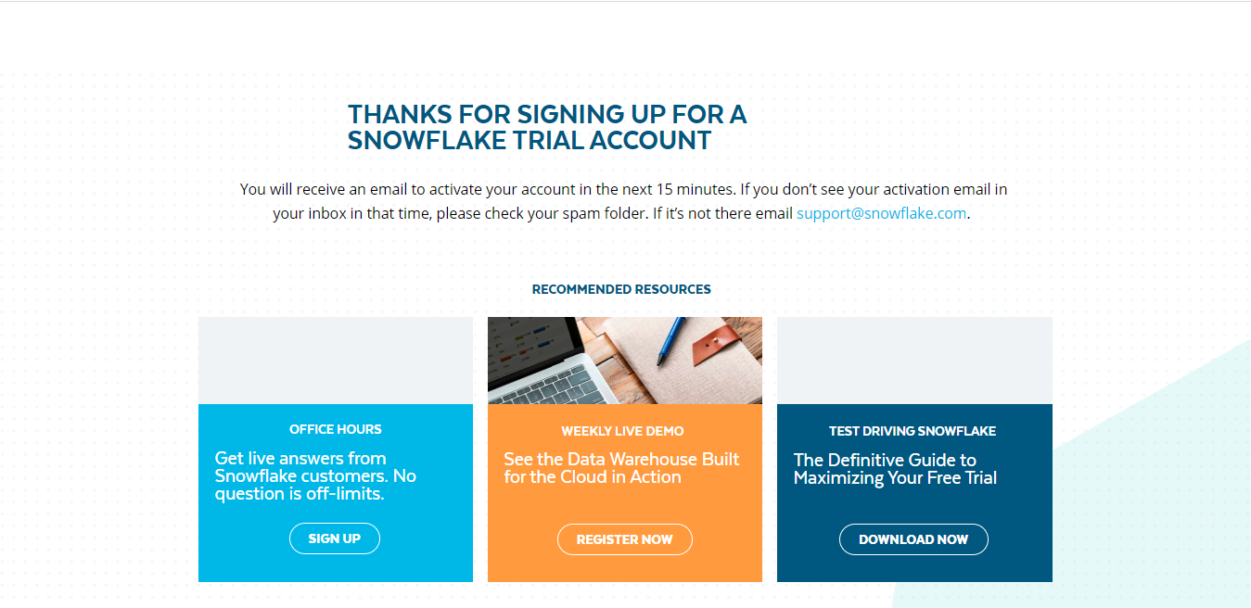
Configuration AWS S3 with Snowflake

Slide 8
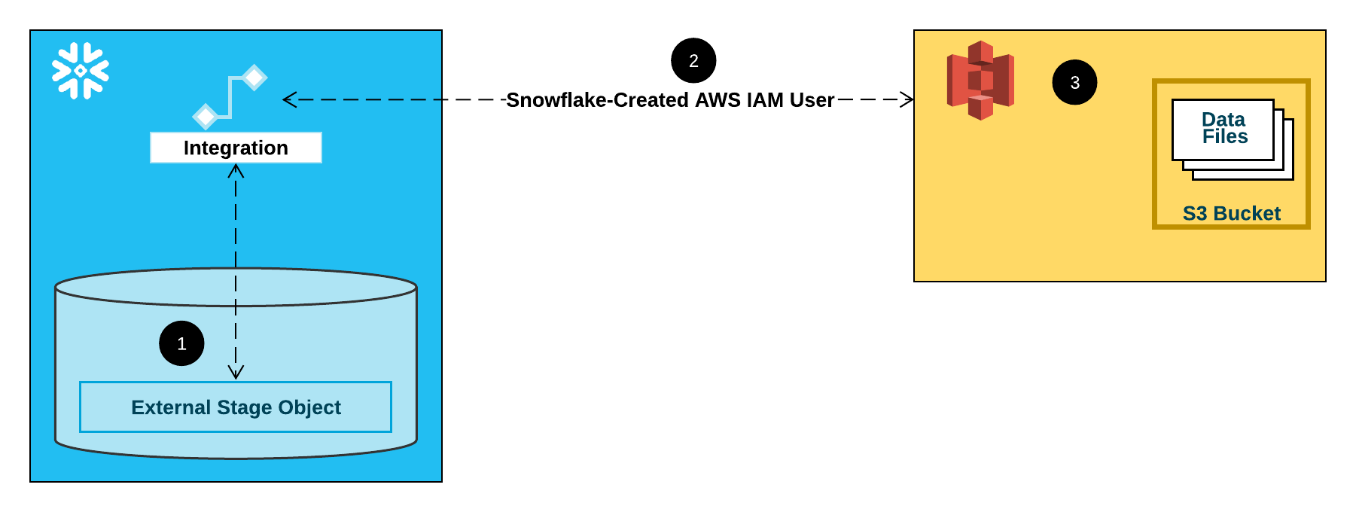
Configuration AWS S3 with Snowflake
However we can setup configurations to migrate data stored in AWS S3 to Snowflake. Once data migration is complete, we do not need to use AWS S3 in any ways.

Slide 9
How snowflake features use AWS S3 strengths
Amazon Web Services (AWS) have been chosen as the initial platform for Snowflake for two main reasons.
First, AWS is the most mature offering in the cloud platform market.
Second (and related to the first point), AWS offers the largest pool of potential users.

Slide 10
How snowflake features use AWS S3 strengths
More importantly, S3 is a blob store with a relatively simple HTTP(S)-based PUT/GET/DELETE interface.
Objects i.e. files can only be (over-)written in full.
It is not even possible to append data to the end of a file.
In fact, the exact size of a file needs to be announced up-front in the PUT request. S3 does, however, support GET requests for parts (ranges) of a file.
These properties had a strong influence on Snowflake's table file format and concurrency control scheme.
Tables are horizontally partitioned into large, immutable files which are equivalent to blocks or pages in a traditional database system.
Within each file, the values of each attribute or column are grouped together and heavily compressed, a well-known scheme called PAX or hybrid columnar in the literature [2].
Each table file has a header which, among other metadata, contains the offsets of each column within the file.
Because S3 allows GET requests over parts of files, queries only need to download the le headers and those columns they are interested in.

Slide 11
What is the limitations of S3 while integrated with Snowflake warehouse
Snowflake services are independent of the choice of the cloud provider.
Snowflake is integrating S3 internally, so we are not performing any integration operation.
Also, no matter which cloud provider we choose for snowflake we are not going to find in terms of price(for a specific region), or features or advantages are limitations.

Slide 12
Comparison and is there any additional benefits when snowflake data warehouse configured and integrated with other cloud providers like MS Azure and GCP
Snowflake is a single, near-zero maintenance platform delivered as-a-service.
So no matter what cloud provider we choose AWS or Azure or GCP, we are not going to find any difference in terms of additional benefits or its services.

Slide 13
Cost efficiency when comparing other cloud providers with AWS
Snowflake Prices are standard in spite of any cloud provider we choose.
Prices vary only depending on the regions.
On-demand Pricing Example
GCP - US-Central1 |  |  | AWS - US |  |  | Azure - US
Standard | $2.00 |  | Standard | $2.00 |  | Standard | $2.00
Standard with Premier Support | $2.25 |  | Standard with Premier Support | $2.25 |  | Standard with Premier Support | $2.25
Enterprise | $3.00 |  | Enterprise | $3.00 |  | Enterprise | $3.00
Business Critical | $4.00 |  | Business Critical | $4.00 |  | Business Critical | $4.00
AWS - Asia Pacific (Singapore) |  |  | AWS - Asia Pacific (Sydney)
Standard | $2.50 |  | Standard | $2.75
Standard with Premier Support | $2.80 |  | Standard with Premier Support | $3.05
Enterprise | $3.70 |  | Enterprise | $4.05
Business Critical | $5.00 |  | Business Critical | $5.50
Azure - Southeast Asia |  |  | Azure - East Australia
Standard | $2.50 |  | Standard | $2.75
Standard with Premier Support | $2.80 |  | Standard with Premier Support | $3.05
Enterprise | $3.70 |  | Enterprise | $4.05
Business Critical | $5.00 |  | Business Critical | $5.50

Slide 14
Snowflake Pricing Structure
Snowflake is paid for as a usage based service.
Each month, you pay for the data you store (at a cost similar to the raw storage costs of Amazon S3), and the number of Snowflake Compute Credits you use for compute.
Each Credit costs around $2, and one Credit provides enough usage for an XS data warehouse for one hour.
A Small data warehouse -the next size up- costs 2 credits per hour and delivers approximately twice the compute horsepower.

Slide 15
The End

